Slide 1
ST KEVINS ZAMBIA PROJECT 2019

Slide 2
SABLES NUA ZAMBIA

Slide 3
SABLES NUA CHILDREN
The children in Sables come from the streets of Kabwe; they have lost parents to HIV or AIDS, been rejected by their families and forced onto the street to beg, steal or prostitute themselves in an effort to stay alive. The children are taken off the streets and given a place of comfort and safety.
There is a shelter at the school for more than 20 boys. They live there and are given a chance in life.
Some of the boys from the shelter

Slide 4
The children get three meals a day.
They get medical care and counselling, clothing and education which gives them, an opportunity for a chance in life.
There is a range of extra-curricular activities from choir to soccer, a knitting club, basketball, volleyball, netball, judo and even a little hurling – on St. Patrick’s Day!

Slide 5
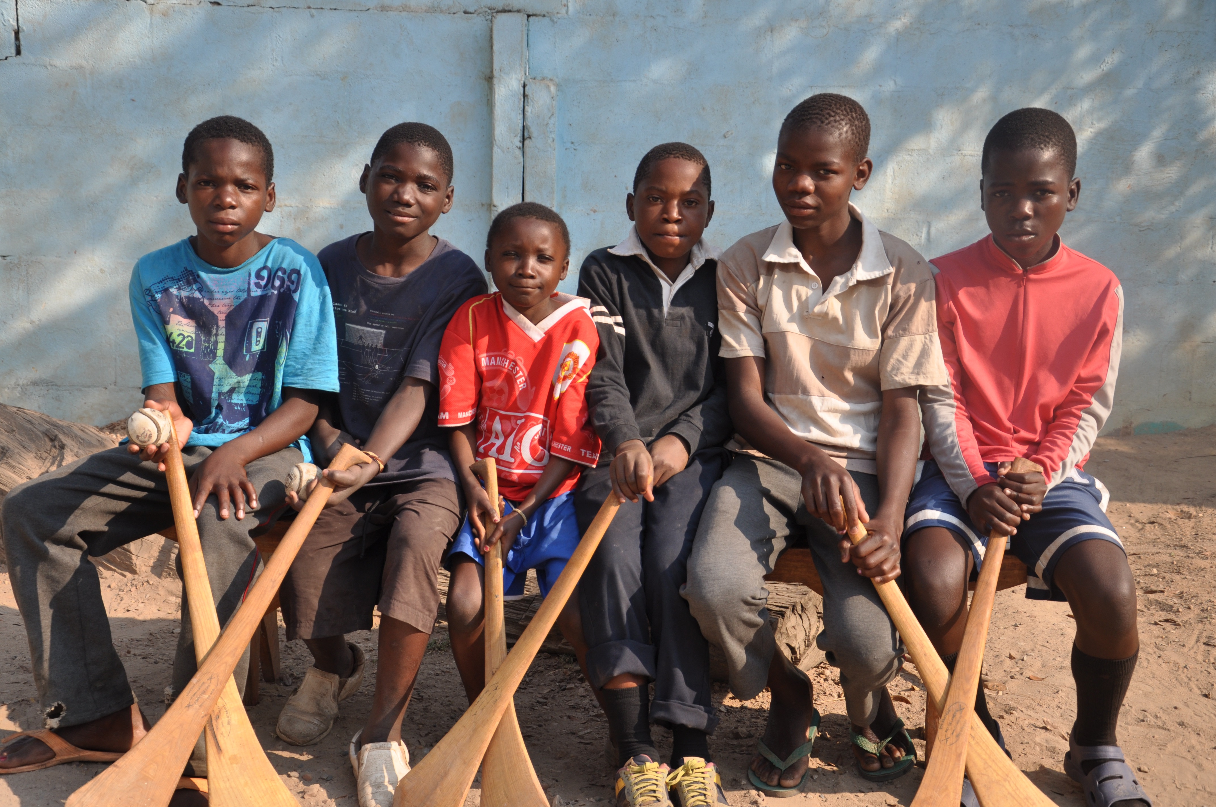

Slide 6
All money donated to Zamda goes to Sables Nua – there are no administration, secretarial costs,or expenses. All money goes exactly where it should go – to support the children of Sables Nua.
Any support given either financial or materially (clothing, stationery, educational supplies, sports materials etc.) is gratefully accepted and put to good use. We donated over €5,000

Slide 7
Over one hundred and thirty children in Sables are ‘day pupils’, coming for breakfast soon after daybreak and staying until they return to their homes (mud huts) as darkness starts to fall.
A new Night Shelter has been built - a dormitory with a shower / toilet block attached is ‘home’ for twenty of the most vulnerable children who have no known relatives ; their life stories are in many cases horrific and Sables is a place of refuge, support and care for them.

Slide 9
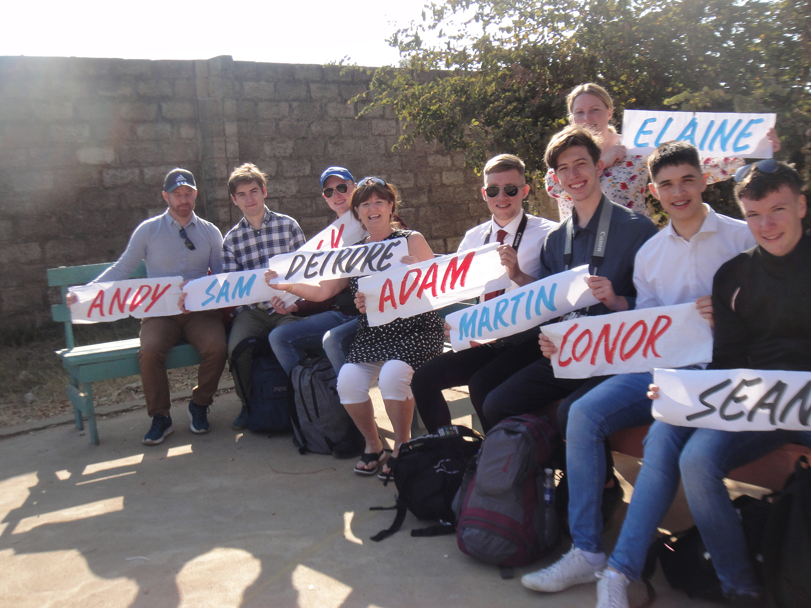

Slide 10
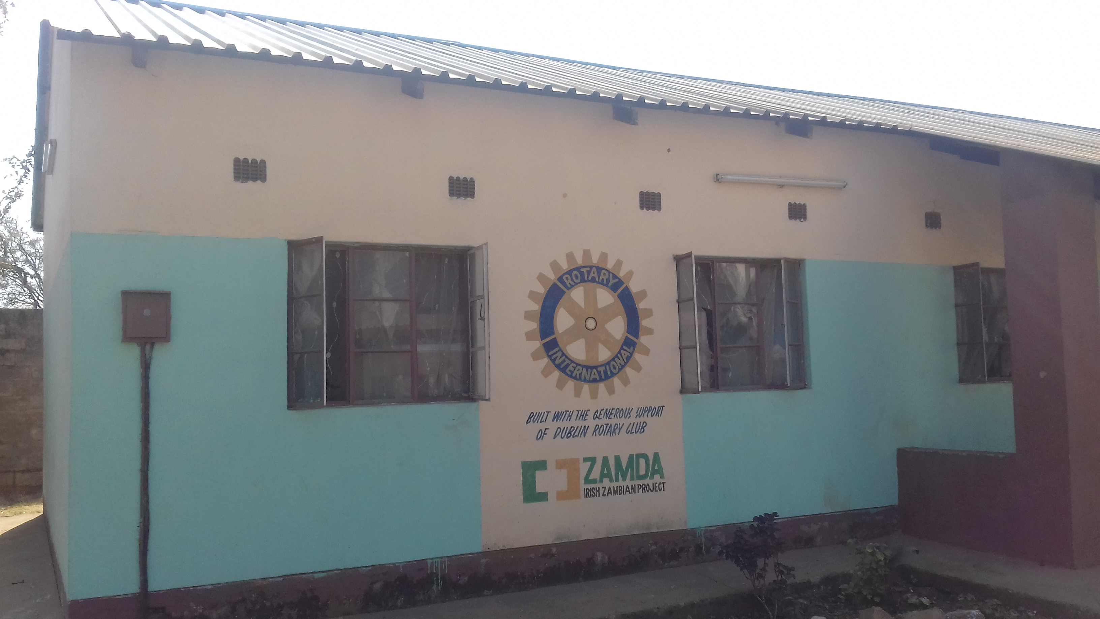

Slide 11
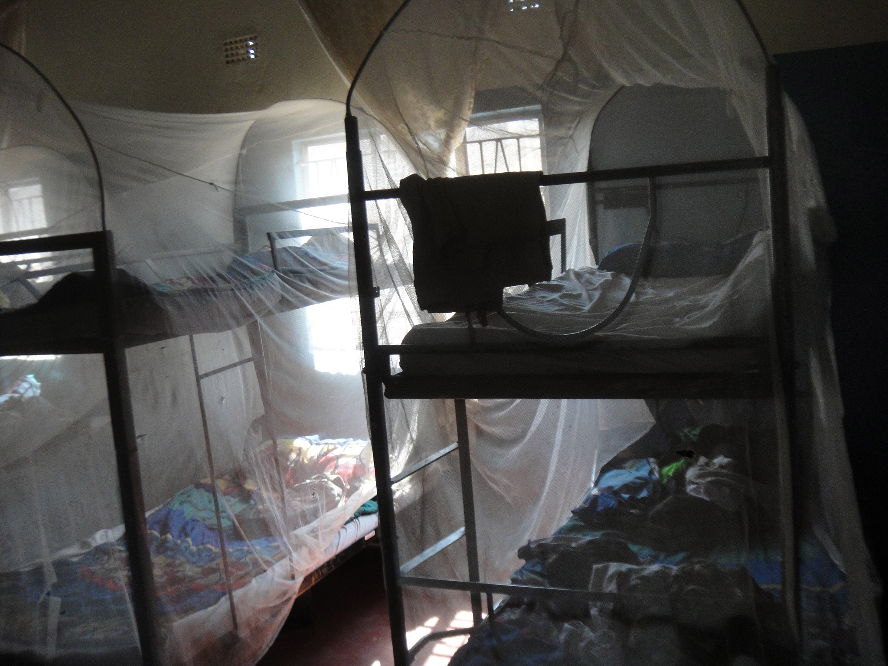

Slide 12
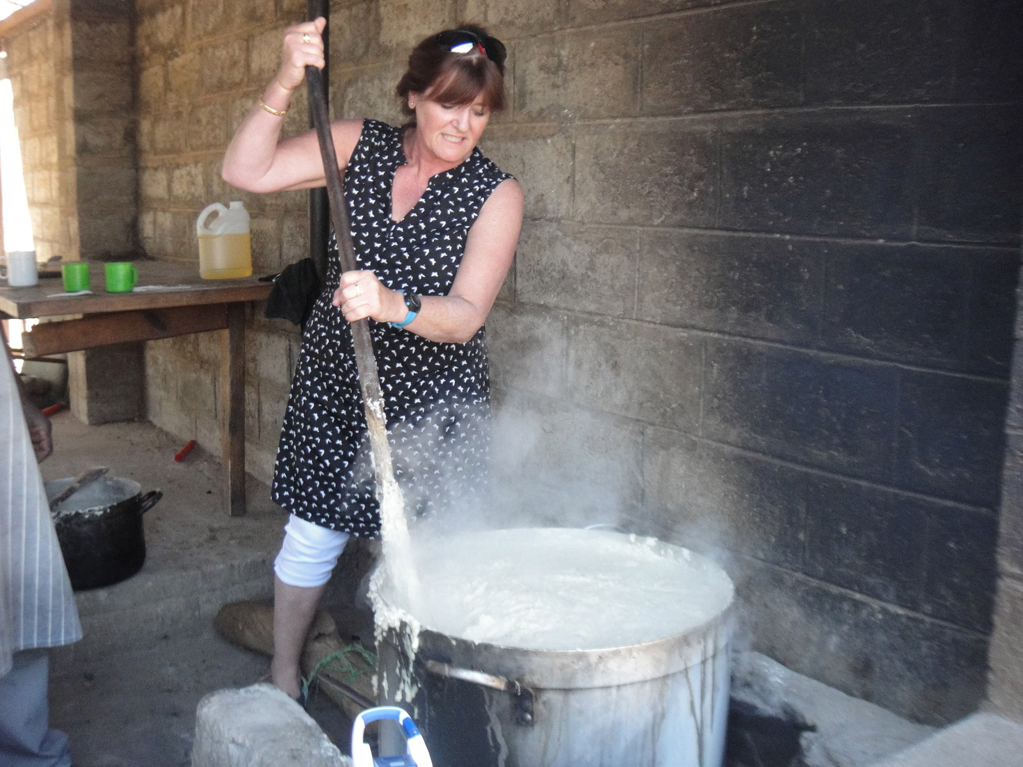

Slide 13
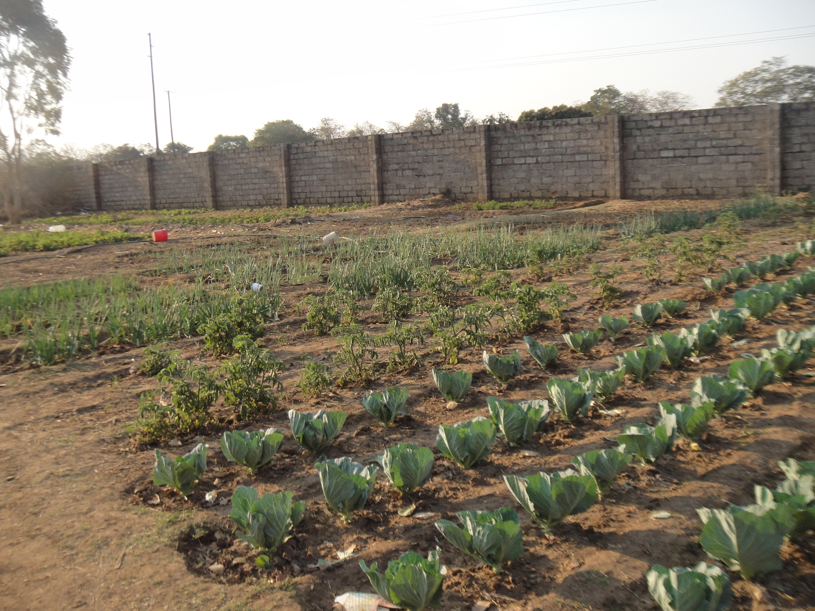

Slide 14
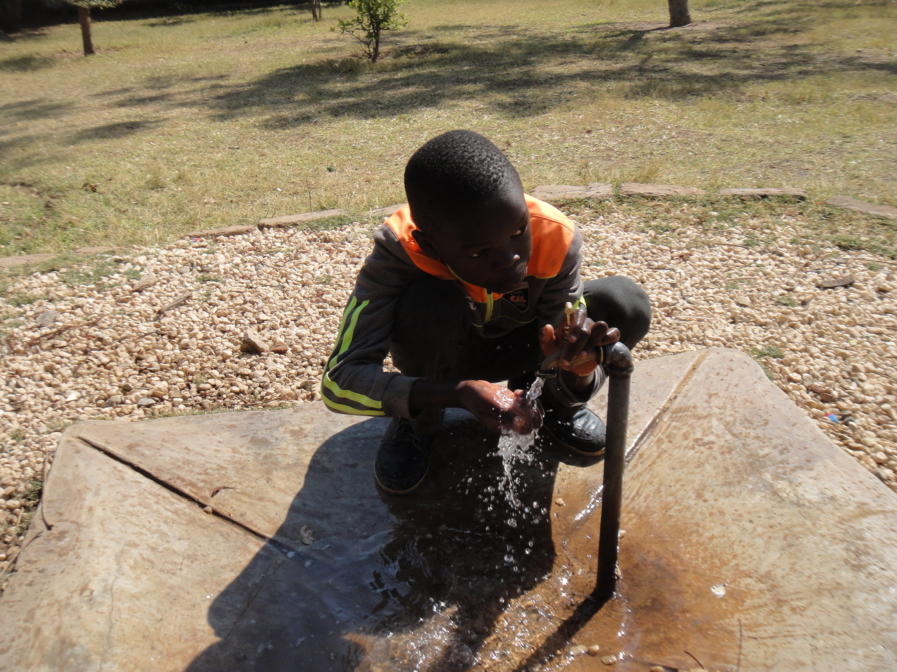

Slide 15
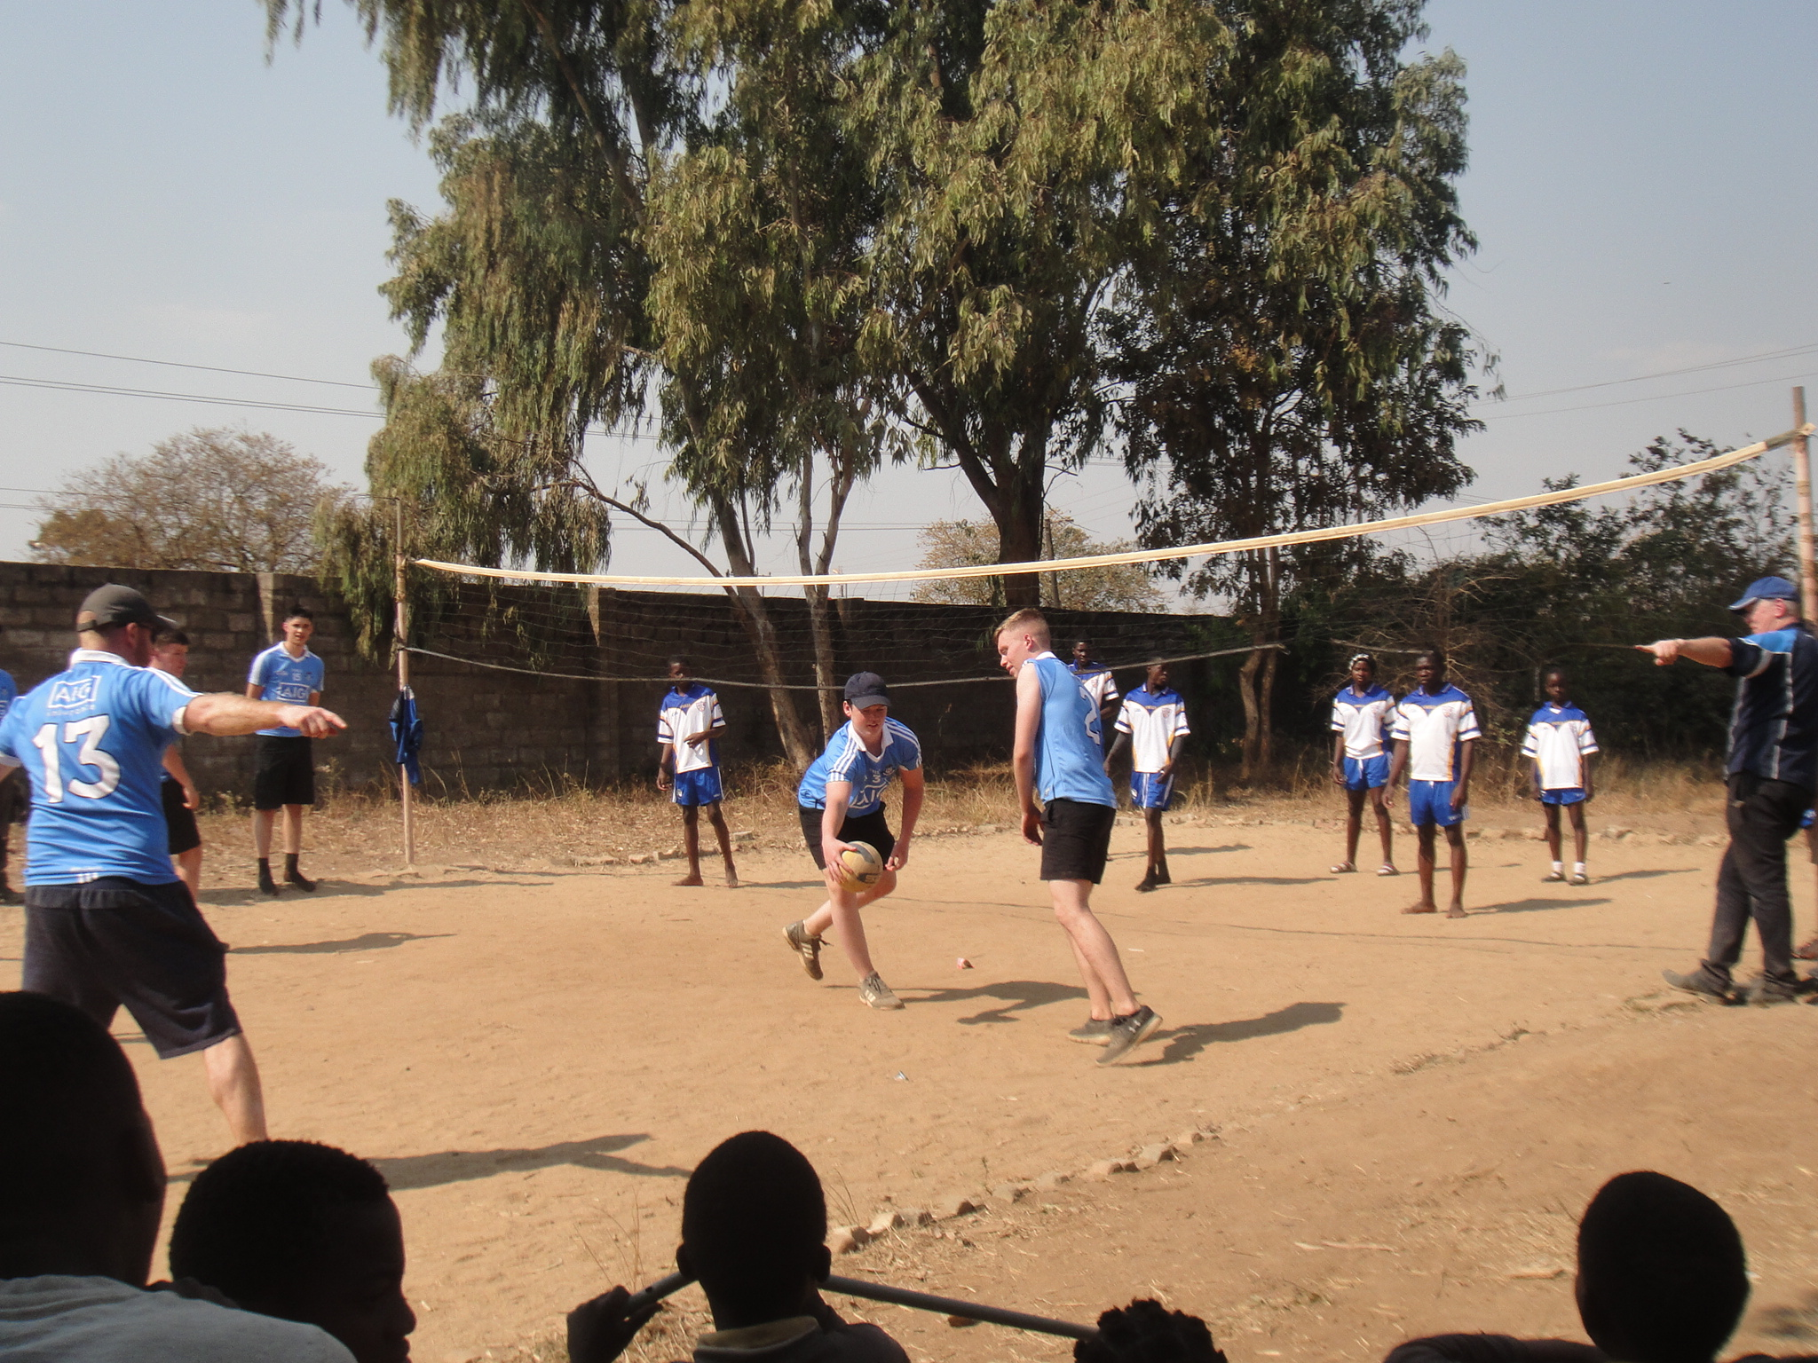

Slide 16
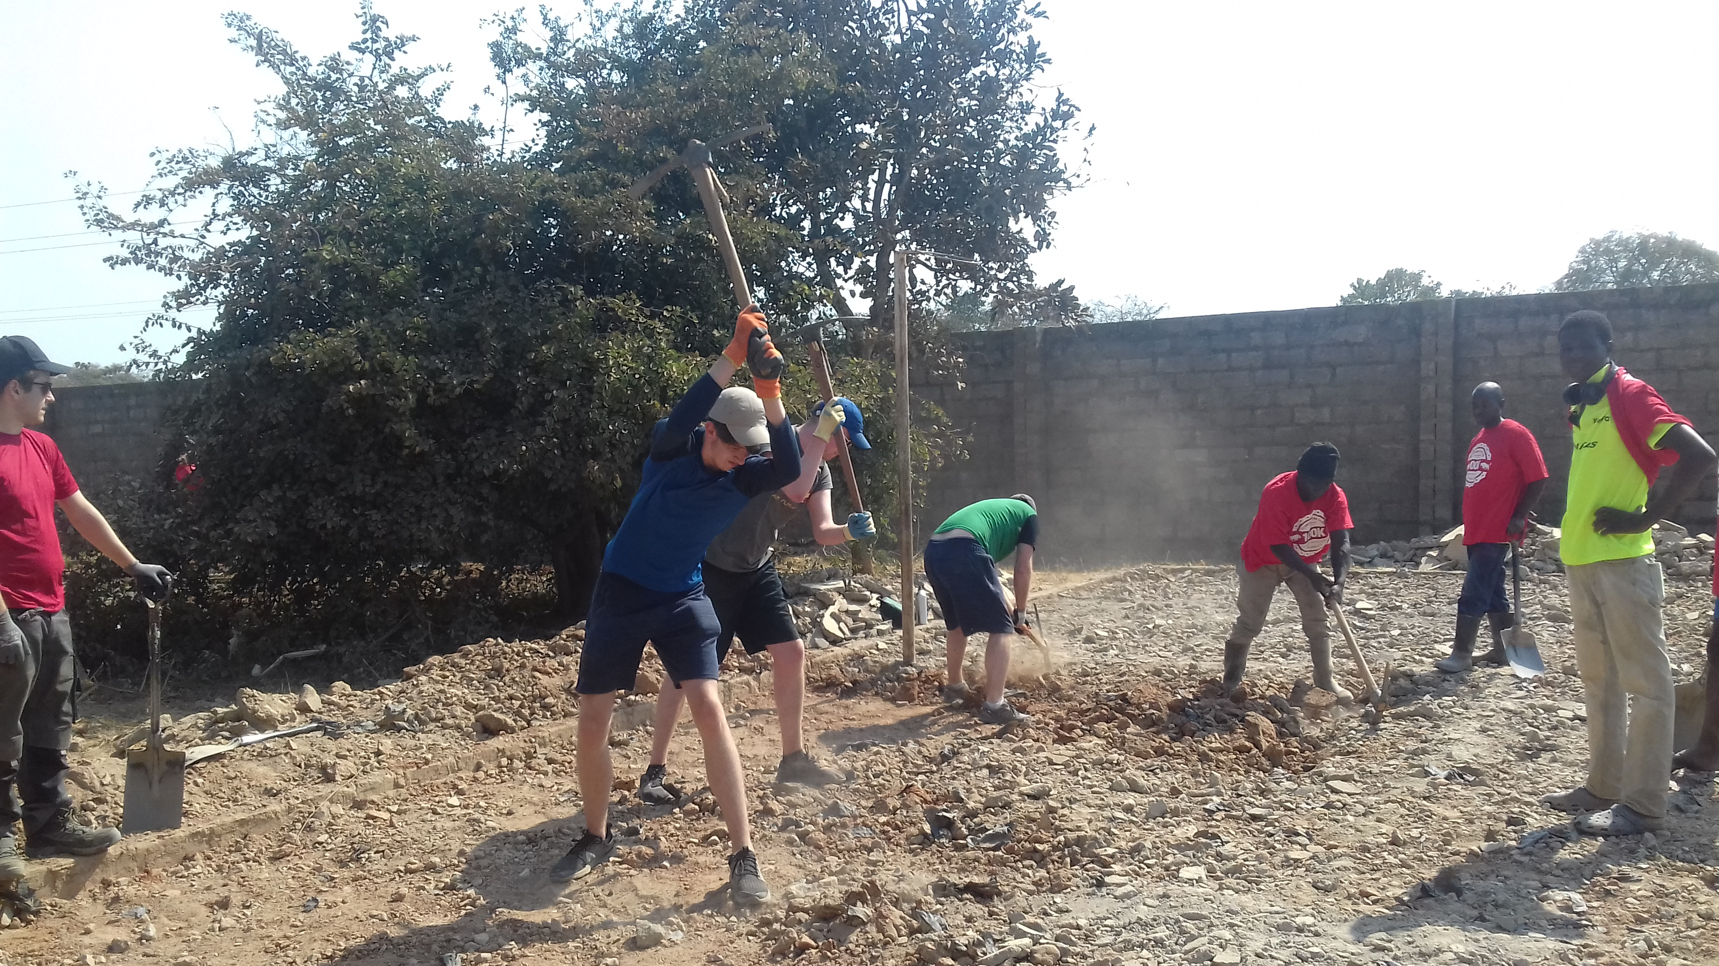

Slide 17
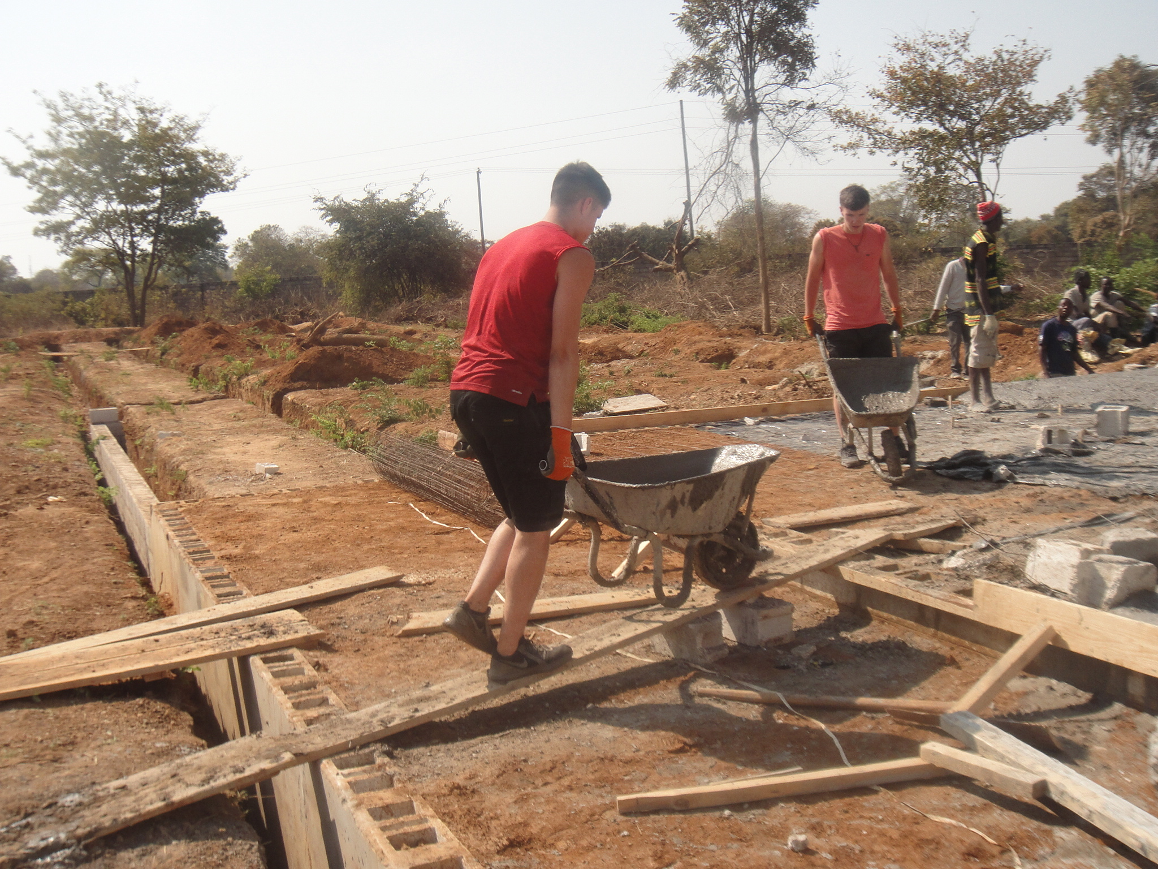

Slide 18
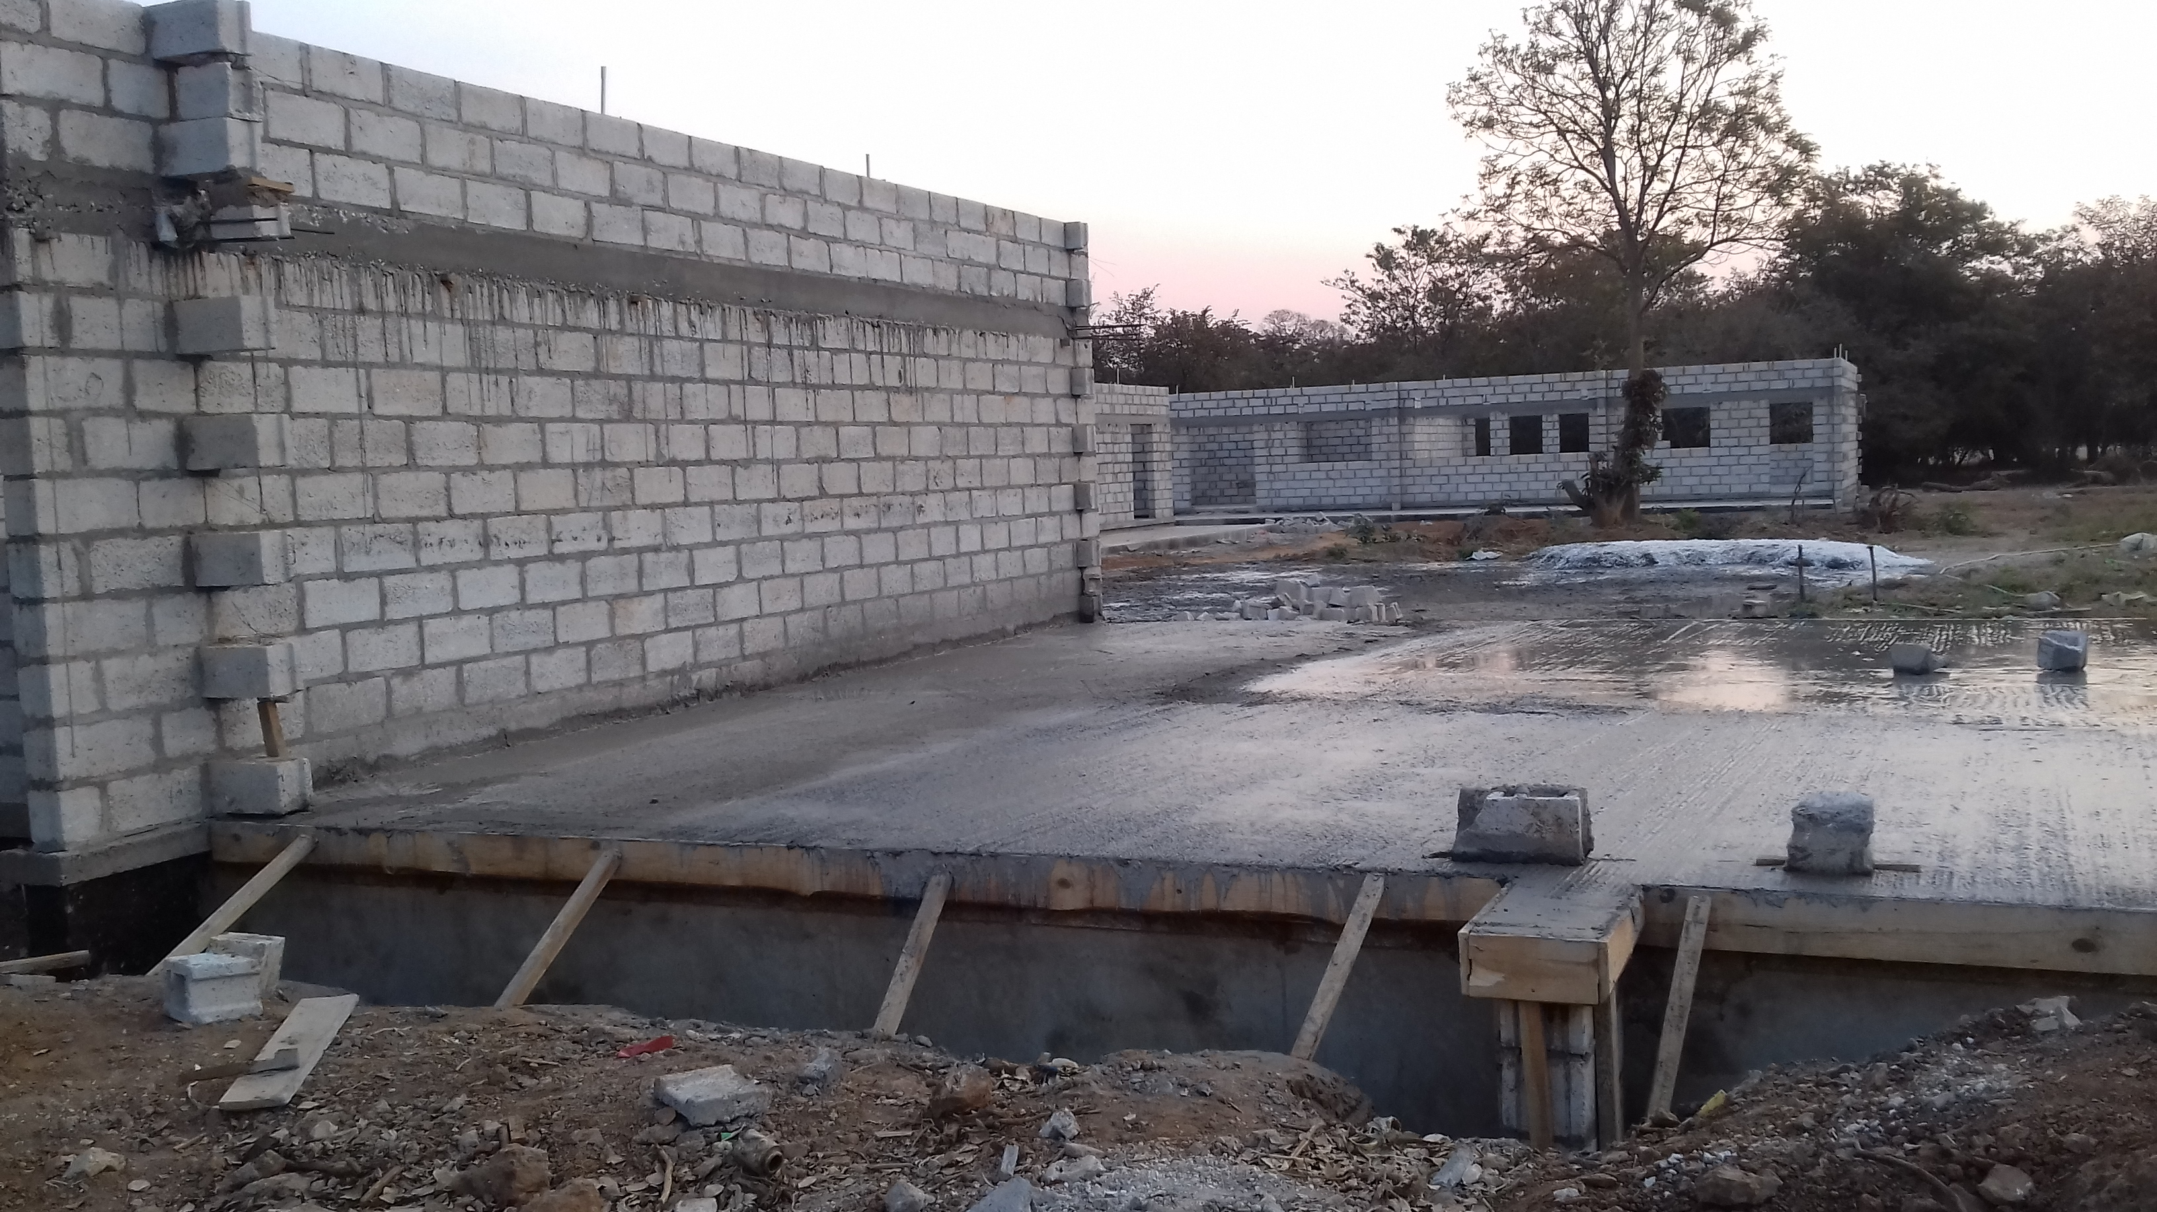

Slide 19
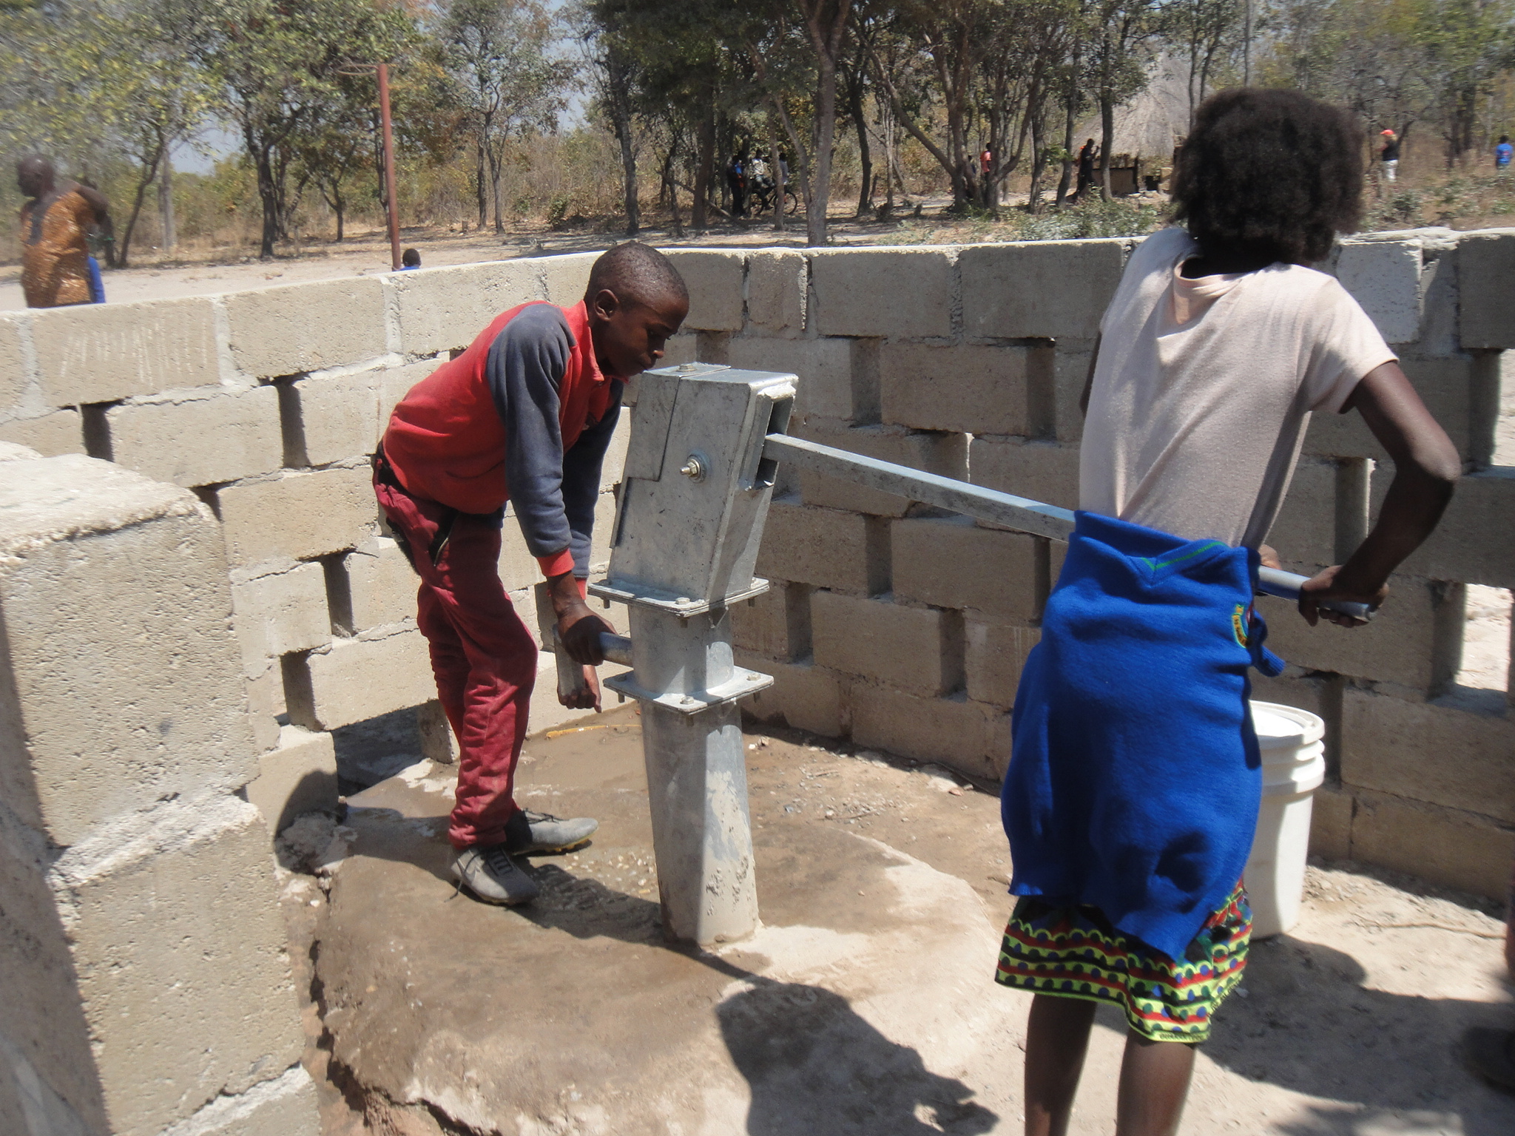

Slide 20
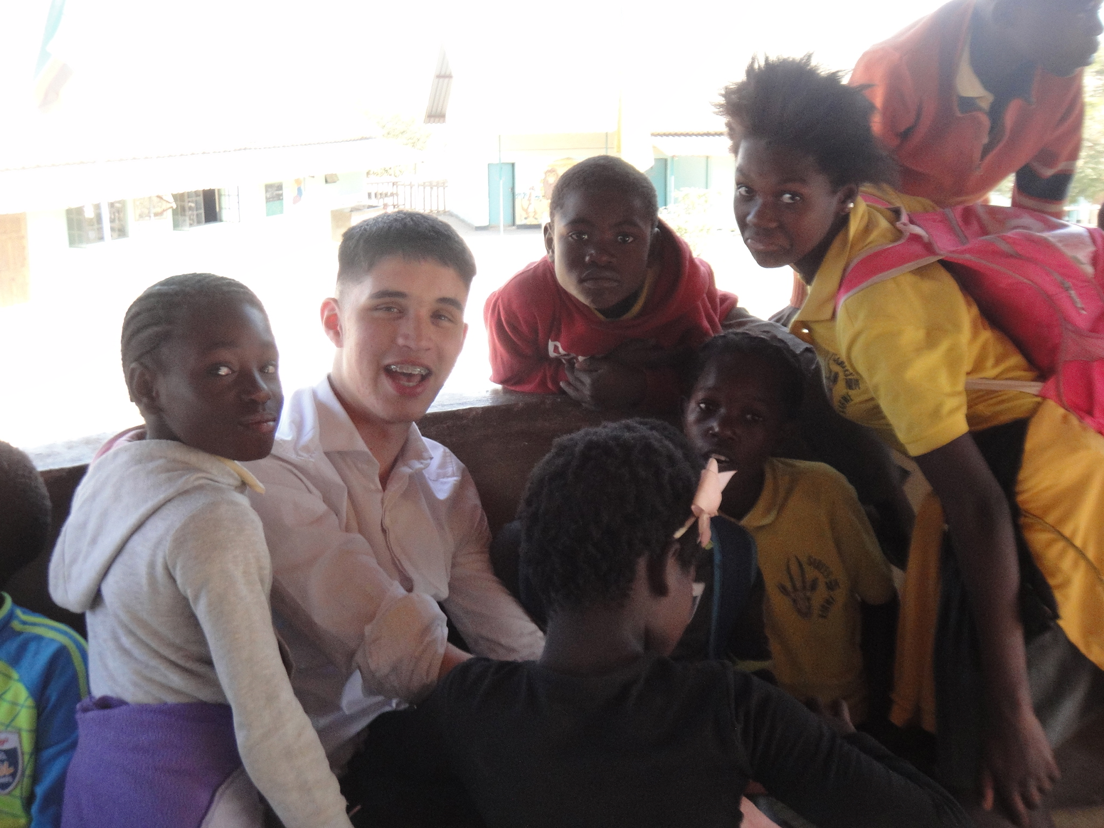

Slide 21
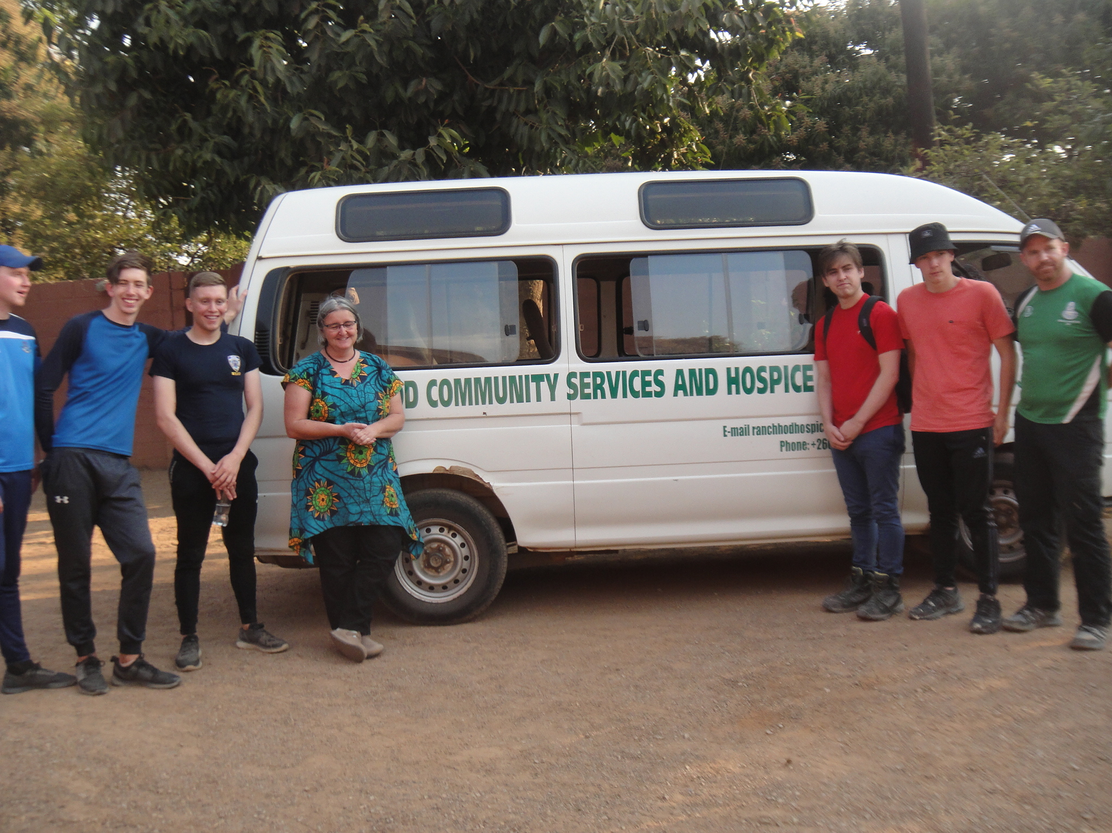

Slide 22
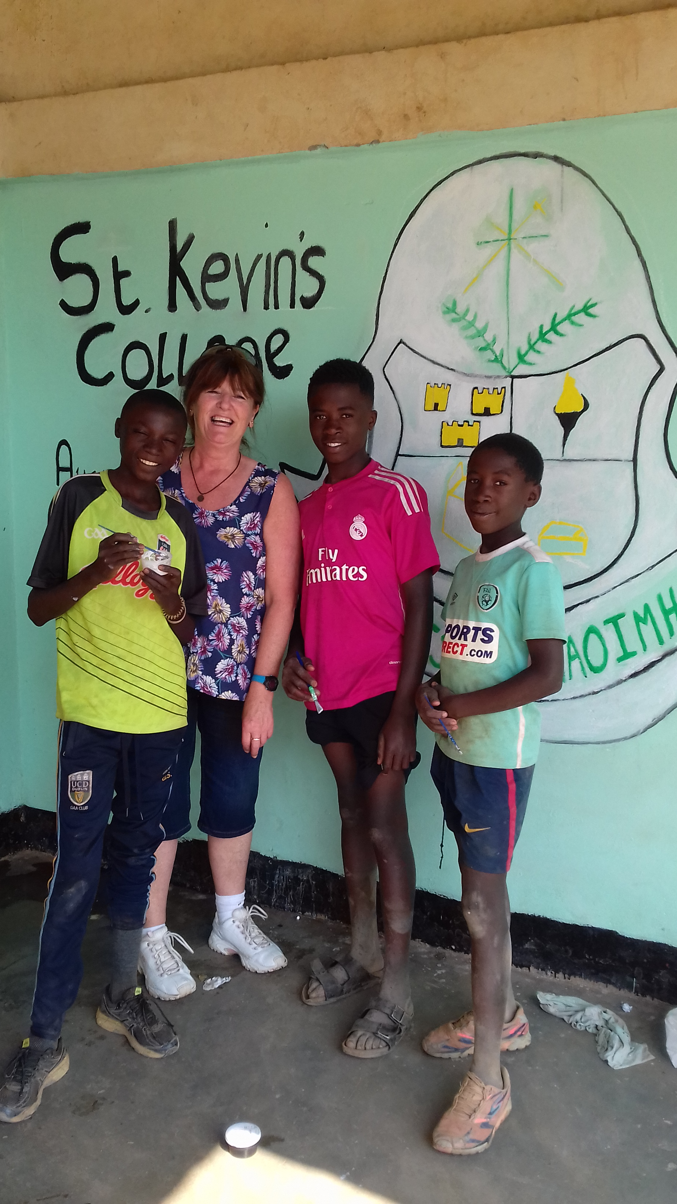

Slide 23
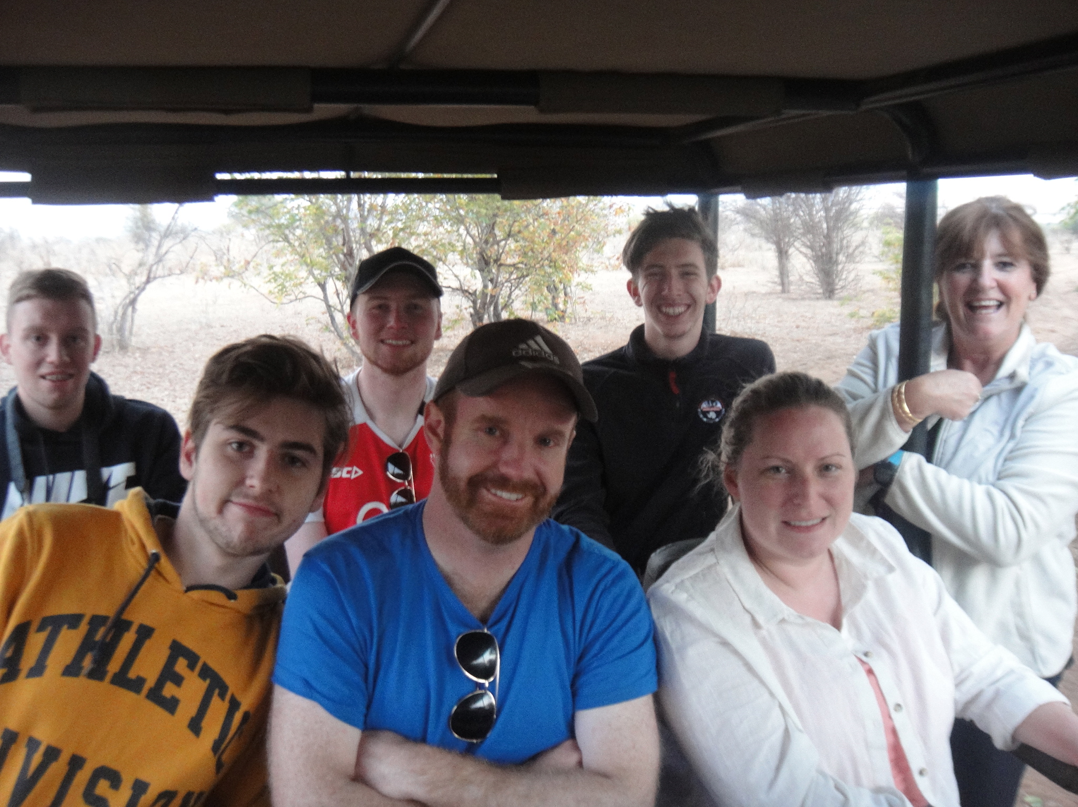

Slide 24
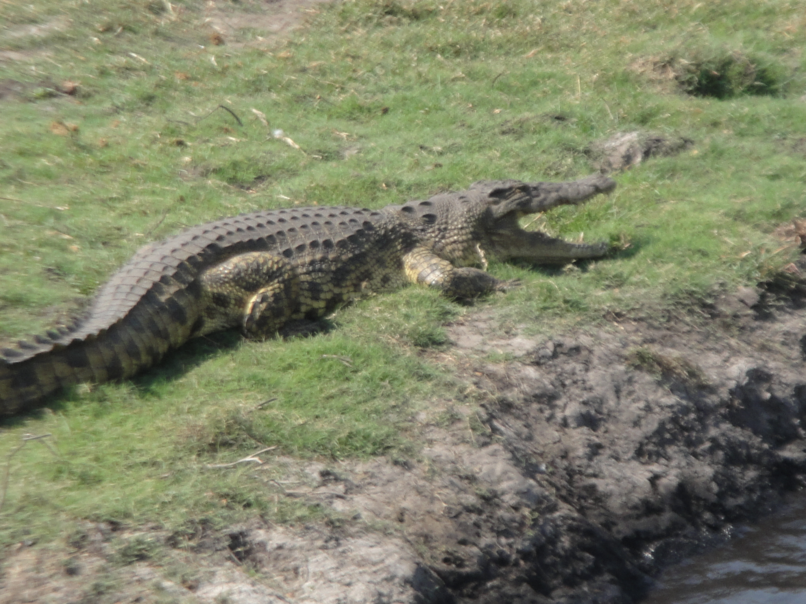

Slide 25
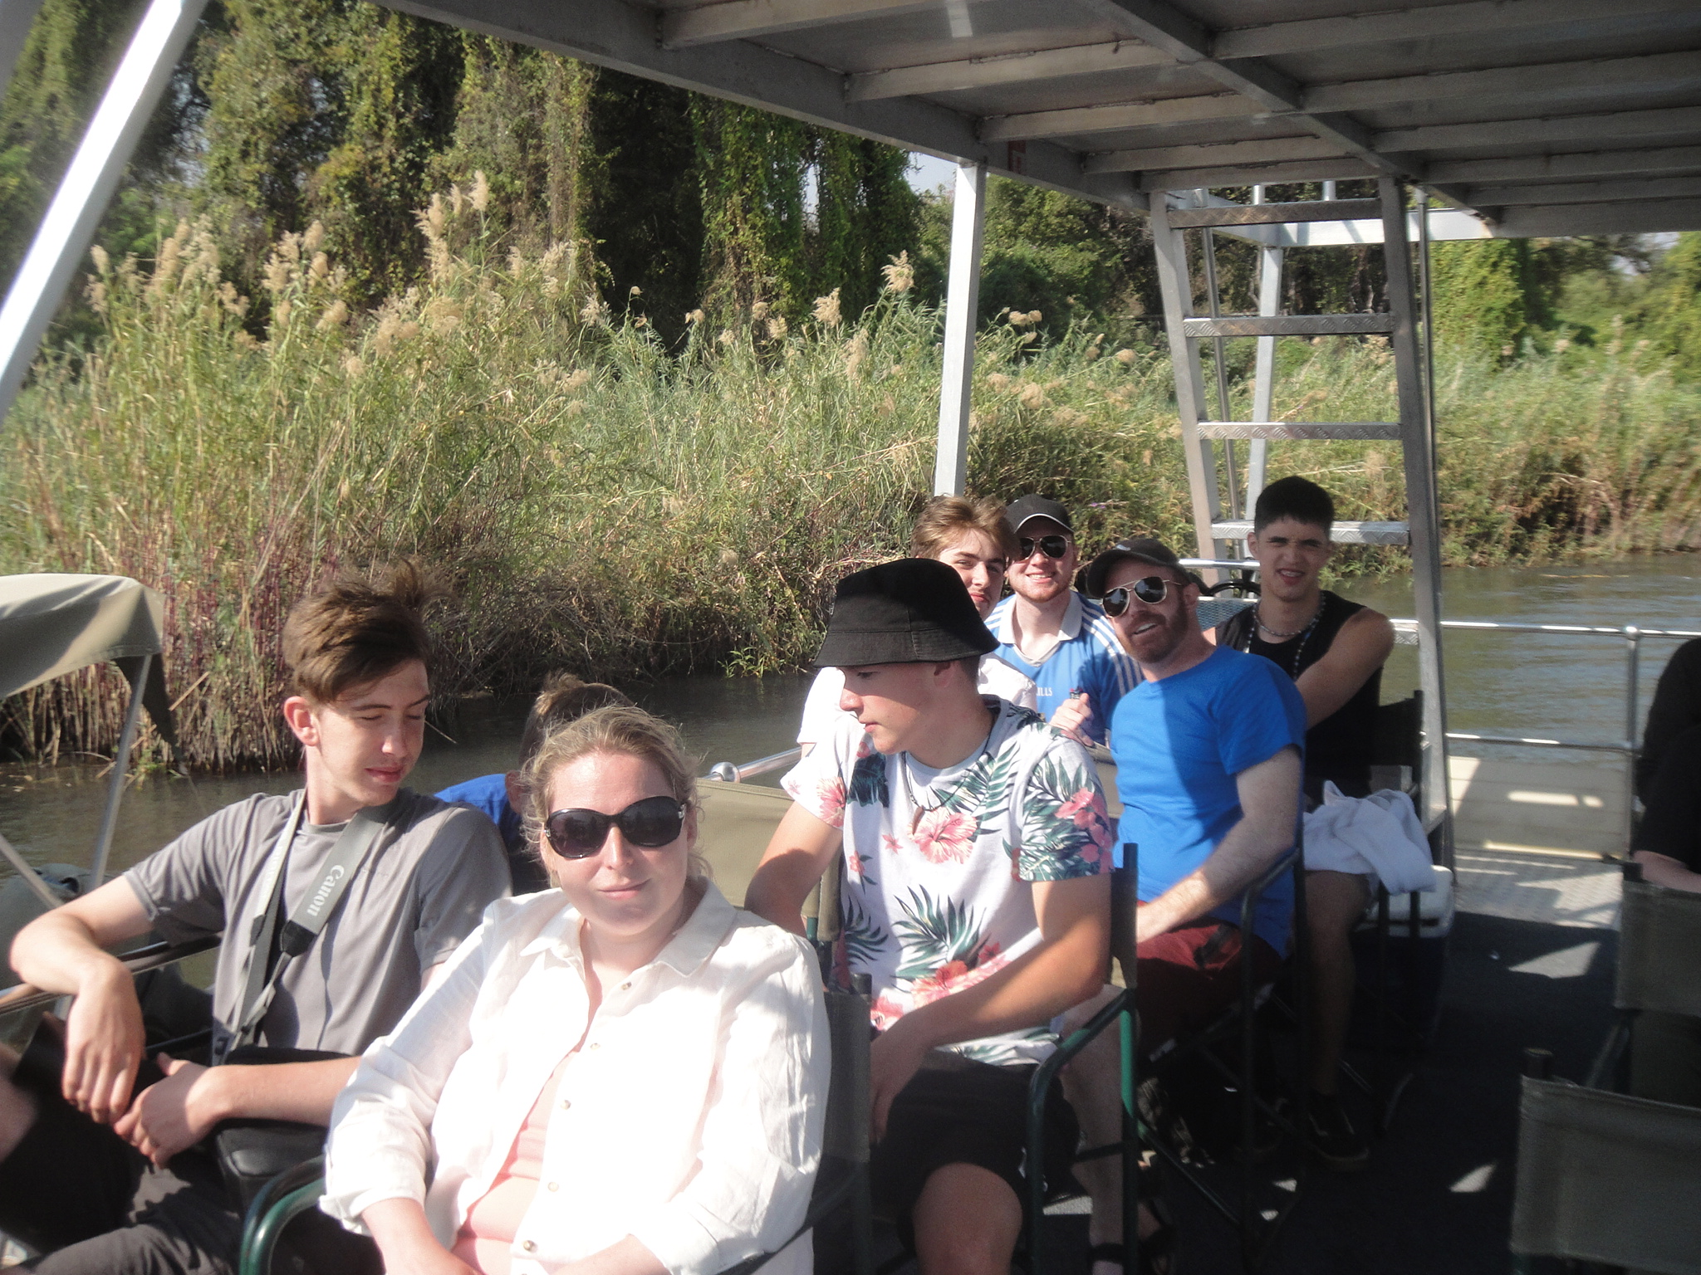

Slide 26
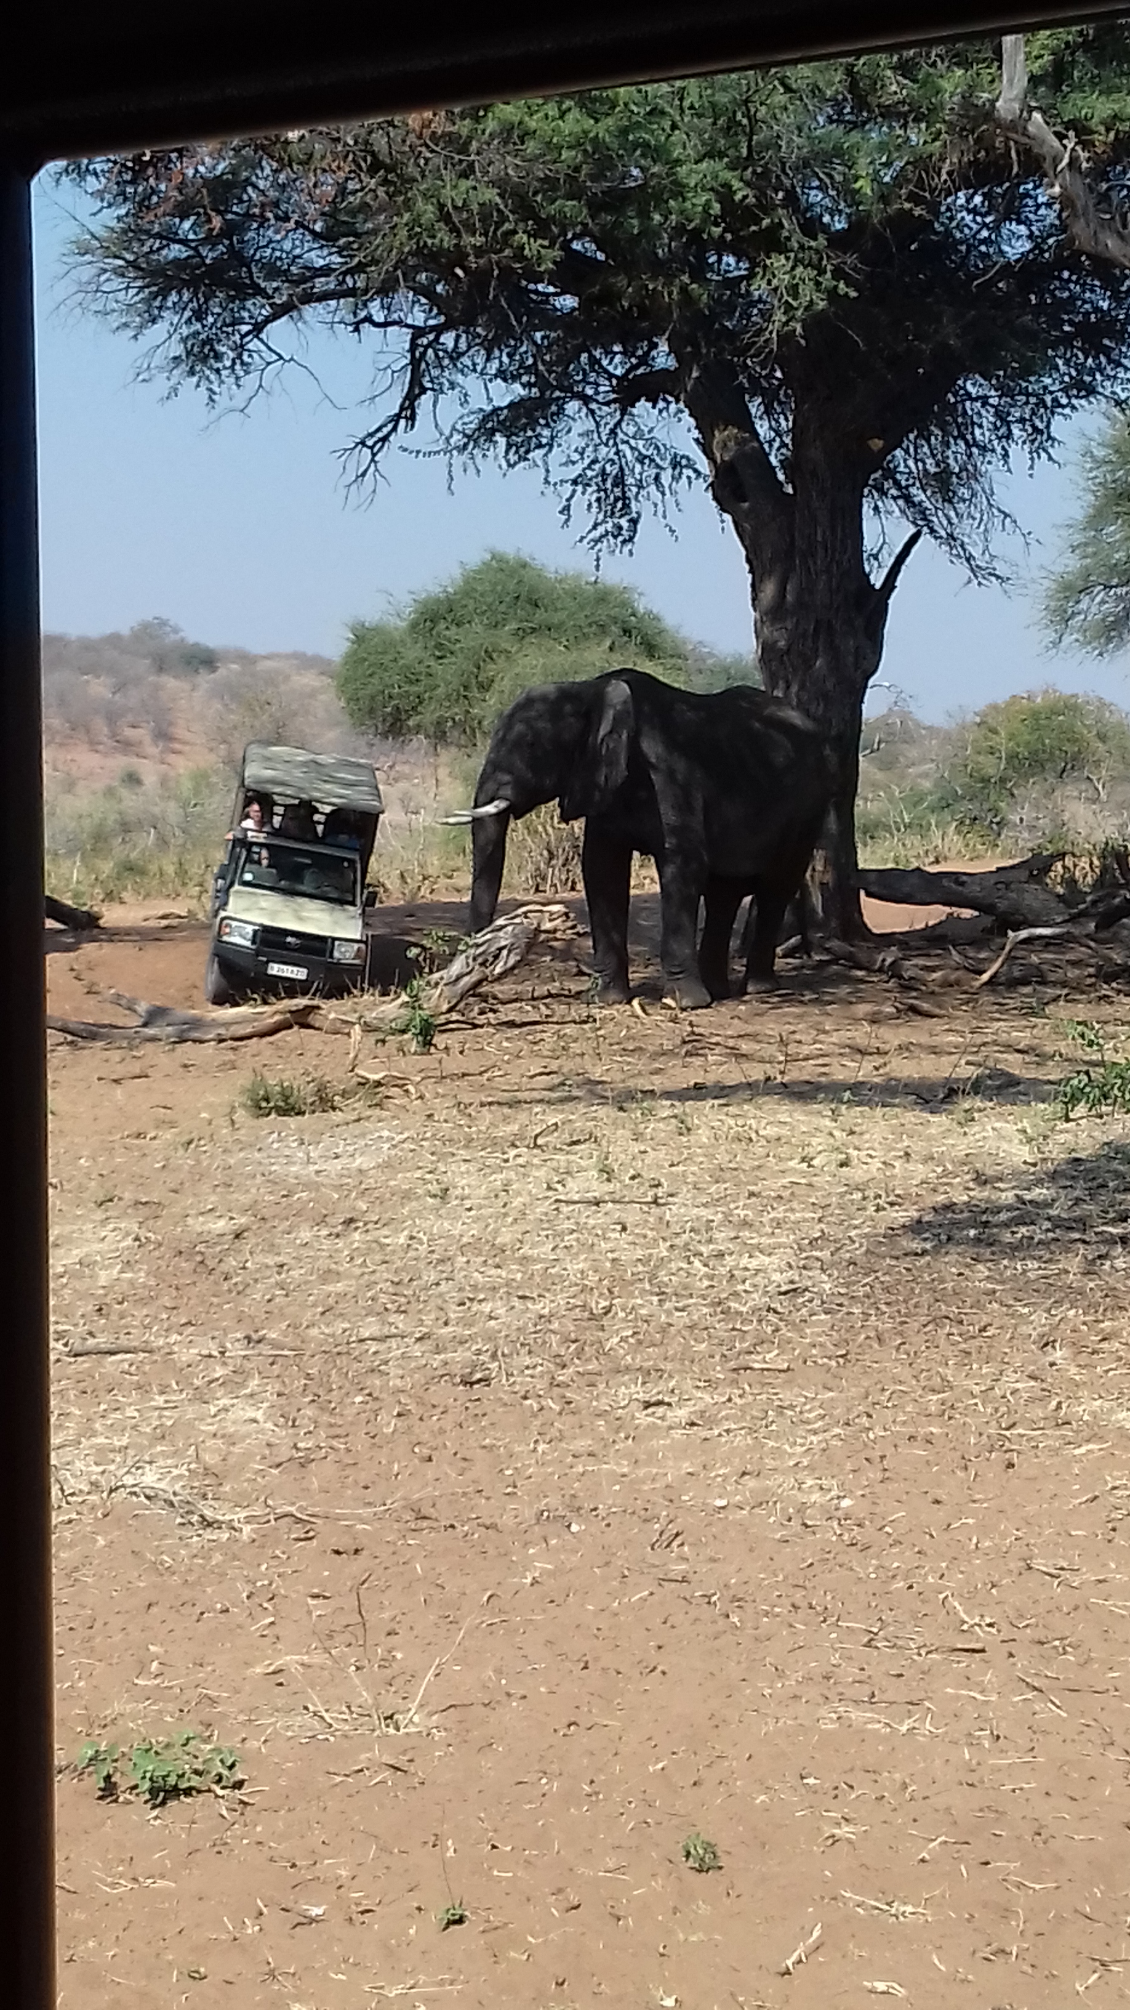

Slide 27
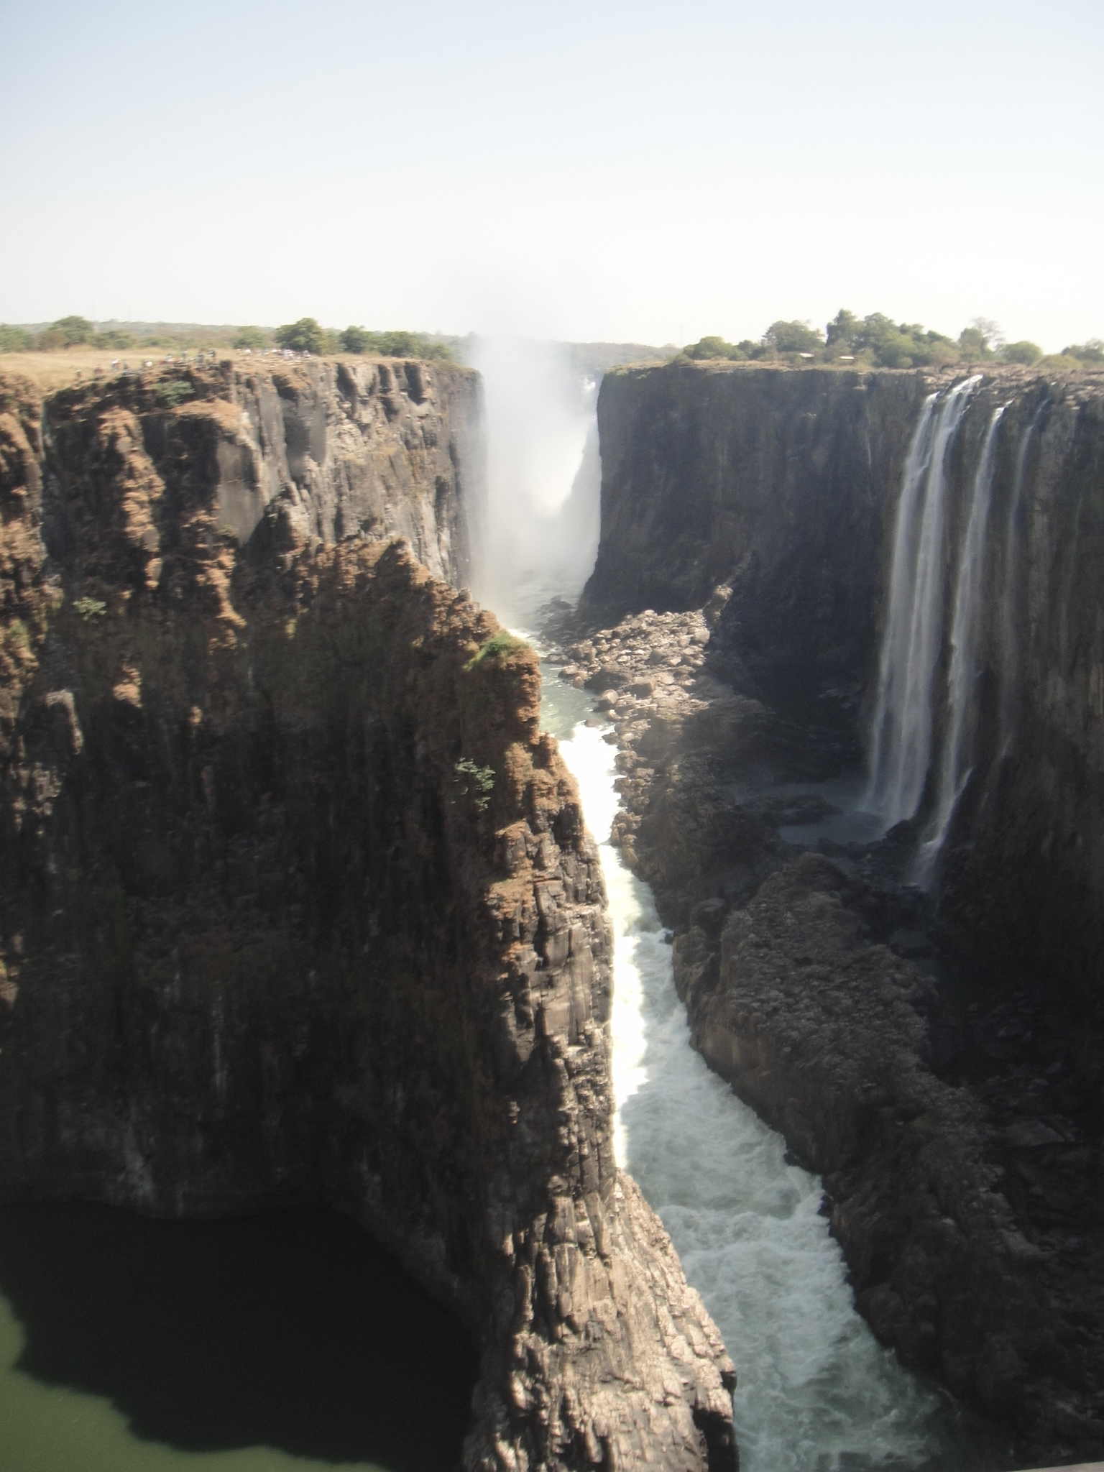

Slide 28
